Slide 1
Urban Heat Island Effect
Krittin Kulrattanaruks, Lilac Hong, Lori Won, Yongqin Zhao
CSE 583, 2023/12/13
Notes:
Idk why but the font sizes are all messed up… please someone fix it :(

Slide 2
Background and Problem Statement
Heat island is a very common phenomenon for urban built environments. and we wonder how this would influence local temperatures.
But current weather patterns cannot provide information at very fine spatial level.
Our project objective is to:
Learn from past year-round city weather data,
Based on urban built environment context like buildings and terrain,
Extract the pattern from hundreds of sample points,
Predict avg. temperature of any given location in the city
Notes:
BACKGROUND Describe the problem or area being addressed.

Slide 3
Data: Acquire, Pre-Process
Data Source:
Seattle City Boundary ¹,
Seattle year-round average temperatures by each weather station ²,
Building footprint with height ³,
Terrain from USGS 3D Elevation Program (3DEP) ⁴, 1/3 Arc Second resolution
Pre-Process:
A bounding box that extend 0.001 degree from actual extent of seattle
Building and terrain data are trimmed to the bounding box
Draw geometry (hexagon) around weather station as learning area of each point
Aggregate temperature and statics of building height and terrain to each station location
1: Seattle City Limits | Seattle GeoData (arcgis.com)
2:Weather Underground
3.microsoft/GlobalMLBuildingFootprints: Worldwide building footprints derived from satellite imagery (github.com)
4.TNM Download v2 (nationalmap.gov)
Notes:
What data did you use? How was it obtained? What are its limitations?

Slide 4
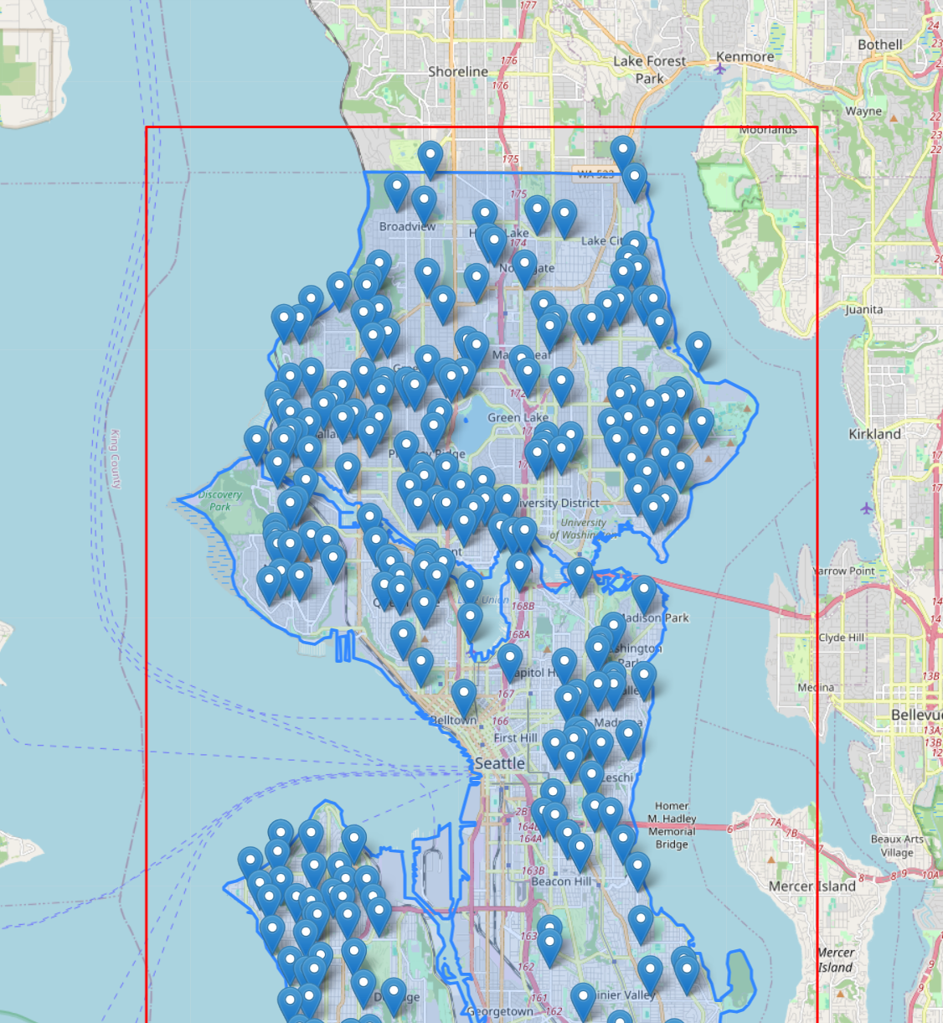
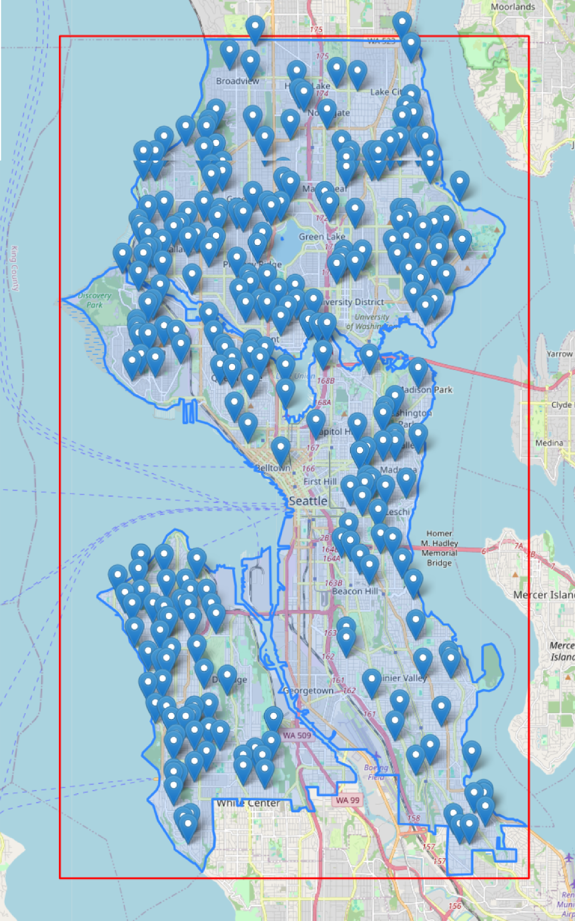
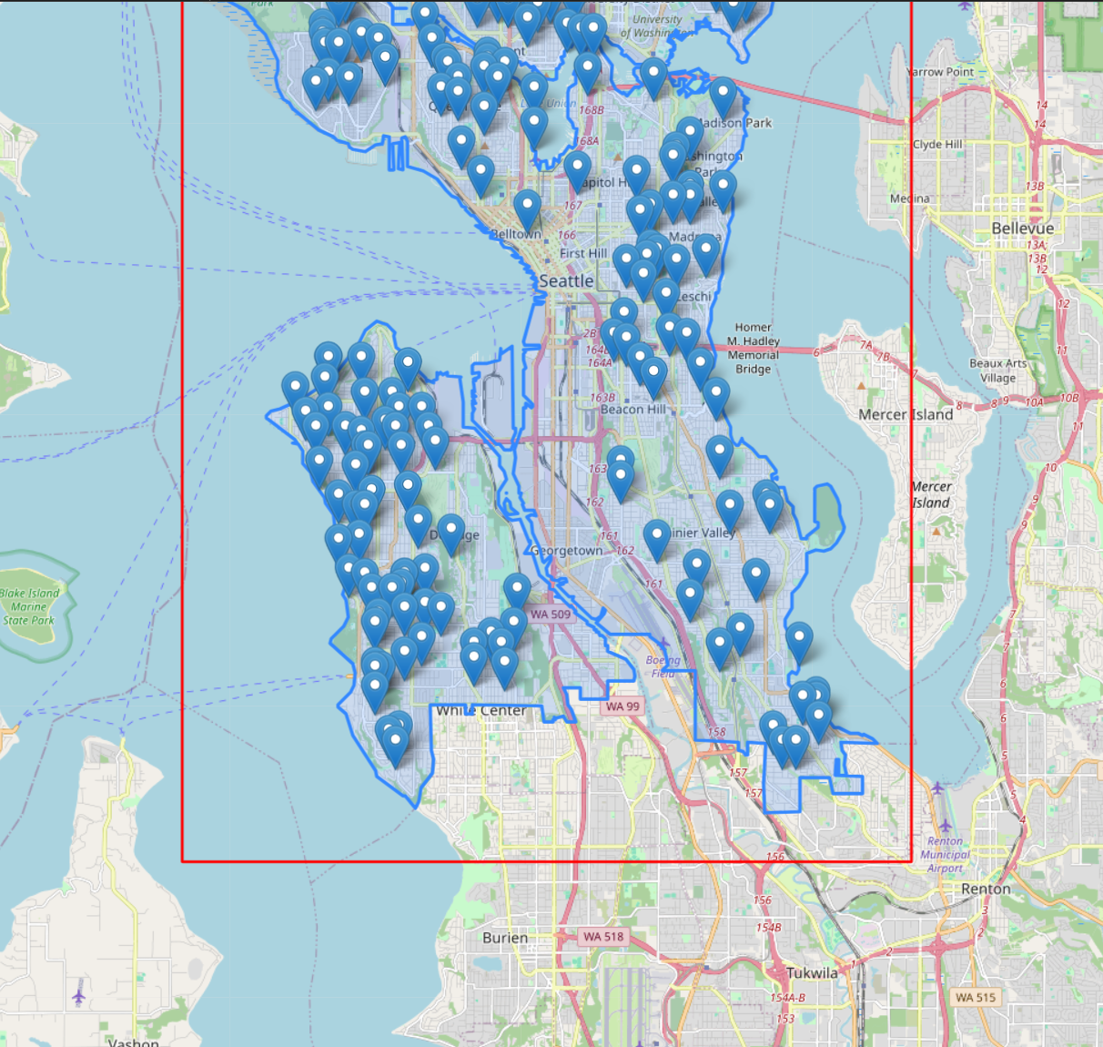
Limitation of the Data
Limitation:
Weather stations in Seattle are not distributed evenly (but that’s one of the reasons for us to predict!)
We only predict the year-round avg. temperatures, and only recent year data is collected.
Notes:
What data did you use? How was it obtained? What are its limitations?

Slide 5
System Design
User
Weather Prediction
Select location
Predict
Map Display of City
Weather Prediction Model
City GeoJSON Data
Building Height Data
City Weather Data
Processing
Training
Notes:
Weather data in CSV
City GeoJSON data (converted from API csv)

Slide 6
Use cases and Components
Selecting building location
Open_browser
Select_coordinate
Find average building height based on a latitude/longitude
Create_hexagon
Height_acquire
Average_building_height_with_centroid
Predict temperature of chosen location
Train
Load_model
predict
Notes:
How users will interact with your system in a way that addresses the problem area.
Check the use cases markdown file in docs

Slide 7

Demonstration of a casual user
Notes:
So it all comes together like this:
Let’s look at the case of a casual user Soynia with a bit of CS background, not much info on Seattle
Click the coordinate where she is looking for a house in Seattle
Waits a little
Data comes out in the box (and maybe also in a bubble, or do maybe in next version for even more friendlier ui)
Test second point in demo (extra fast skip the running step if it takes a bit of time)

Slide 8
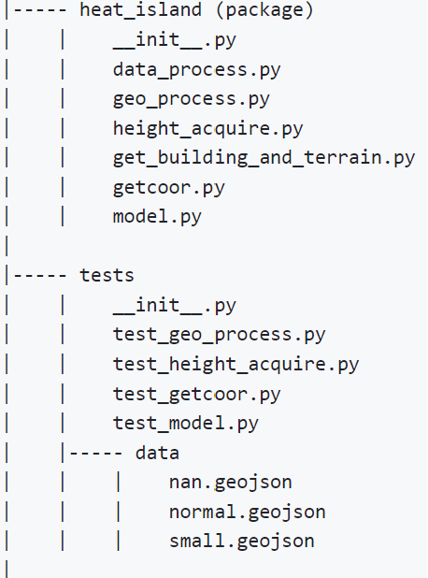
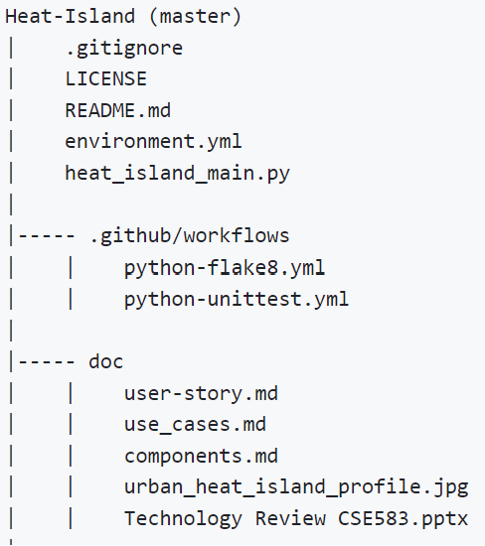
Project Structure
Notes:
Show the structure of your github repository.
Should exist in the readme - probs needs to be updated (there and here!)

Slide 9
Insight & Future Work
KNN with k = 5 is the best model for Seattle weather data. (KNN vs Linear Regression vs RandomForestRegressor)
Building footprint does not have linear relationship with temperature (R² < 0 for linear regression)
Improve UI/UX (No more using terminal)
More training dataset (For more general model)
More function
Input new height and visualize impact to local temperature
Seasonal temperature prediction

Slide 10
Reflection
Worked out well:
More comfortable with git
Great teamwork - linkage between upstream and downstream
Could have done better:
Folium is not dynamic but good for visualizing
Scheduling, we should have stand-ups and set deadline for deliverables
Have consistent documentation style during development

